Slide 1
Take back your time! Let AI do the work for you
Eldert Grootenboer

Slide 2
Notes:
Please do not amend.
Please ensure you make a reference to our sponsors as part of your introduction – without them, we wouldn’t be here today.

Slide 3
Notes:
Please do not amend.
Please ensure you make a reference to our sponsors as part of your introduction – without them, we wouldn’t be here today.

Slide 4



Eldert Grootenboer
@egrootenboer

Slide 5
Take back your time!
Time is precious
Wasted on repetitive tasks
Less time for innovation
Notes:
Copying data between applications
Doing a daily upload of some files
Filling out timesheets

Slide 6
Let AI do the work for you
Gartner predicts 69% of routine work currently done by managers will be fully automated by 2024

Slide 7
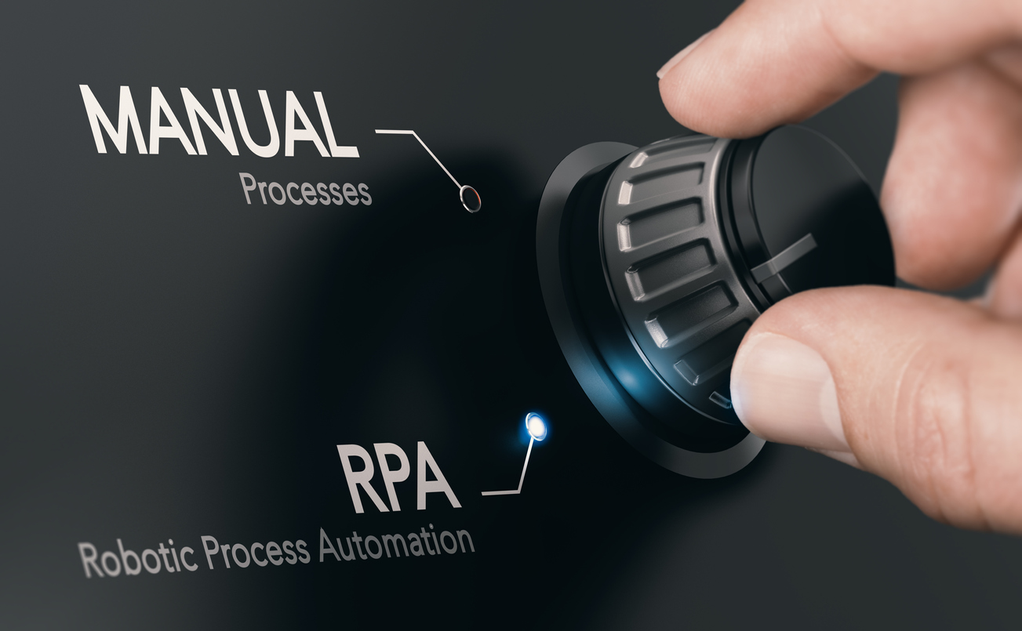
RPA

Slide 8
Introducing RPA
Robotic Process Automation
Virtual workers replicate human actions
Perform repetitive rule-based work
Aide or replace human interaction

Slide 9
RPA with Power Automate Desktop
Windows and web applications
Record user interface actions
Test the recording
Play back and monitor

Slide 10

Demo
Let AI help you
Notes:
Power Automate - Take back your time; Let AI do the work for you! - Demo 3
Power Automate Desktop - Take back your time; Let AI do the work for you! - Demo 3
Use Power Automate to retrieve entries from Outlook
Call Power Automate Desktop for 3 customers
Fill in data for Contoso, Fabrikam and Northwind in TimeChimp (Website)
Fill in data for Fabrikam in Time Tracker (Windows application)
Fill in data for Northwind in Excel and send mail from Power Automate Desktop (Show Excel and Outlook capabilities and other possibilities)

Slide 11
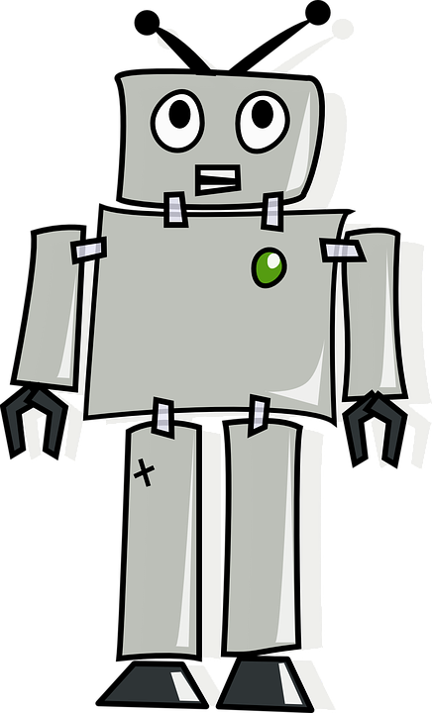
Almost done

Slide 12
Take aways
Automate
Automate repetitive tasks
Easy
Very low-entry to do complex work
Integrate
Combine the various services

Slide 13



Thank You!
@egrootenboer
eldert@eldert.net
https://www.linkedin.com/in/eldert-grootenboer
Notes:
Rustig spreken!

Slide 14
Notes:
Please do not amend this slide.
Please ensure you close with this slide – do not delete!
As you close, please remind people:
Charity Quiz (Charity is Breast Cancer) kicks off at 7pm in the ballroom. Registration required (link via South Coast Summit Website).
Sponsored Drinks at 5.30 in the Atrium / Expo Hall and Ballroom Foyer.

